Slide 1

UNIVERSITY DATABASE MANAGEMENT SYSTEM
MTH 141

Slide 2
TEAM MEMBERS
DEVI PRIYA.G
DARSHITHA.M
PRIYA DARSHINI.A
KAMALIKA.B
VARSHA.A
NIKHIL.L
NITESH SAI.C

Slide 3
DATA BASE MANAGEMENT SYSTEM:
Database Management System (DBMS) is a software for storing and retrieving users' data while considering appropriate security measures. It consists of a group of programs which manipulate the database.

Slide 4
UNIVERISTY DATABASE MANAGEMENT SYSTEM:
University Database Management System also know as University Software. University Management Software is developed to manage the University's student database. As the University grows their database also grows and for the proper management of the data a great database management system is required.

Slide 5
.
ENTITIES
AND ATTRIBUTES:
ENTITIES | ATTRIBUTES
Student | Id First name Last name Age Dob Blood group Gender M/F Year enrolled for Phone number Address
Faculty | Id First name Last name Age Dob Blood group Gender M/F Salary Phone number Address

Slide 6
Payment | Payment Id Amount Mode of payment Concession/scholarship Paid amount Due amount Date of payment Due date for payment Remaining amount Payment status
Course | Course Id Title Hours No of modules Handling faculty Lab session Theory session Total sessions Beginning date Ending date

Slide 7
Grade | Student id Course id Exam grades Exam percentage On time submission Late submission Assignments done Assignments pending Total assignments final grade
Placement | College name College code Recruit count Internship duration Trainee duration Trainee salary Job salary Position offered Paid/unpaid Certified/not certified

Slide 8
Parking | Id Date Time Vehicle no Vehicle colour Vehicle in time Vehicle out time Phone no Address

Slide 9
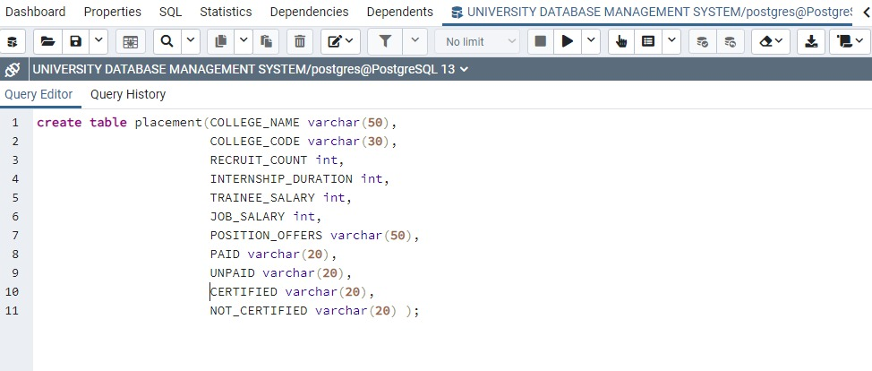
SQL QUERIES placement query

Slide 10
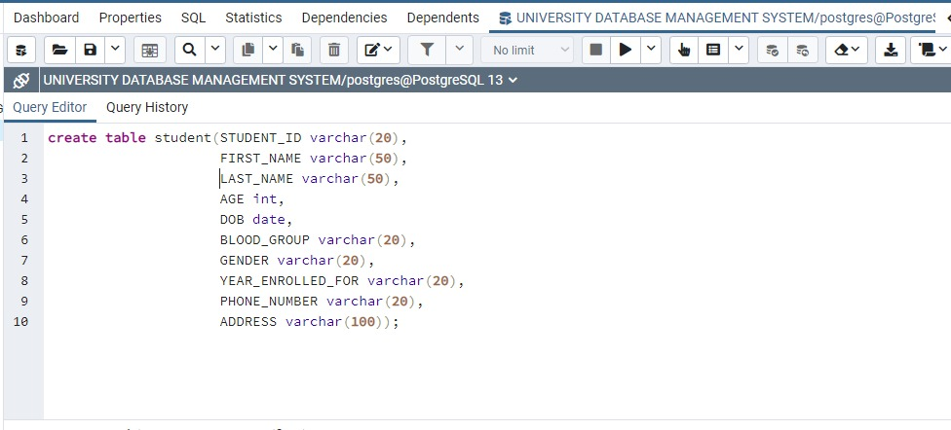
Student query

Slide 11
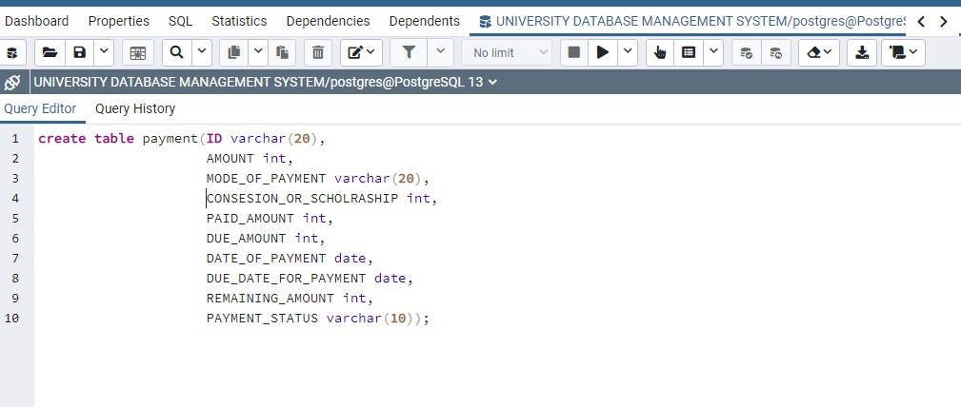
Payment query

Slide 12
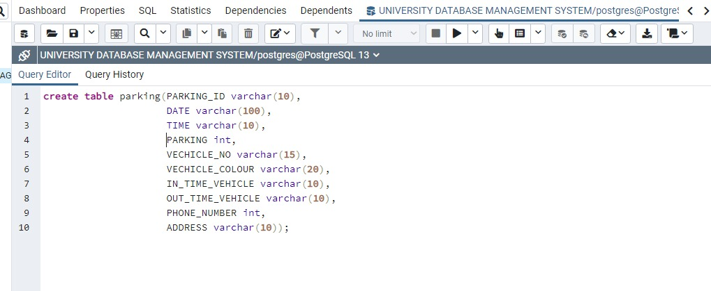
Parking query

Slide 13
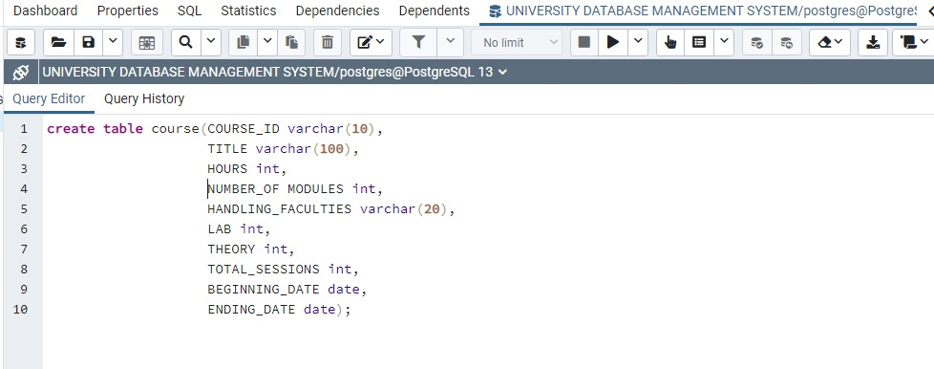
Course query

Slide 14
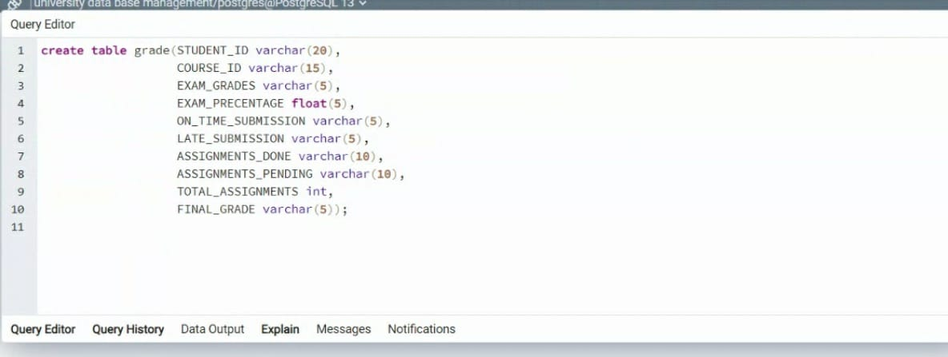
Grade query

Slide 15
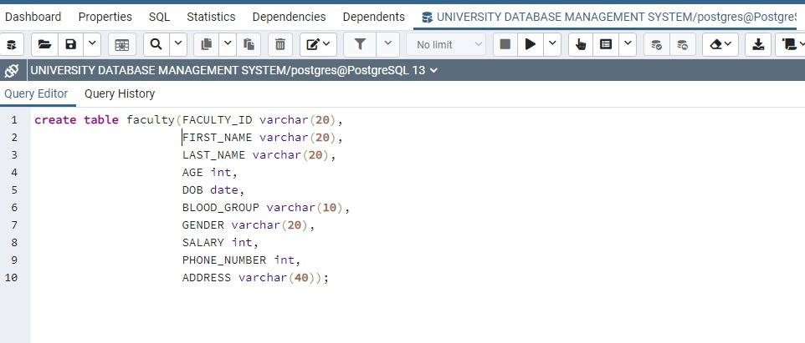
Faculty query

Slide 16
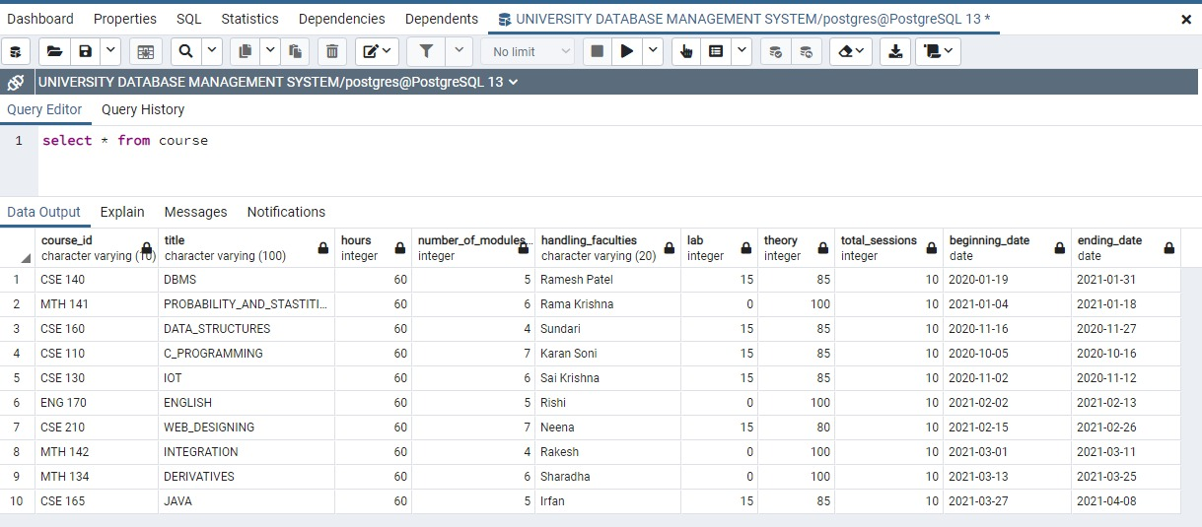
Outputs course table

Slide 17
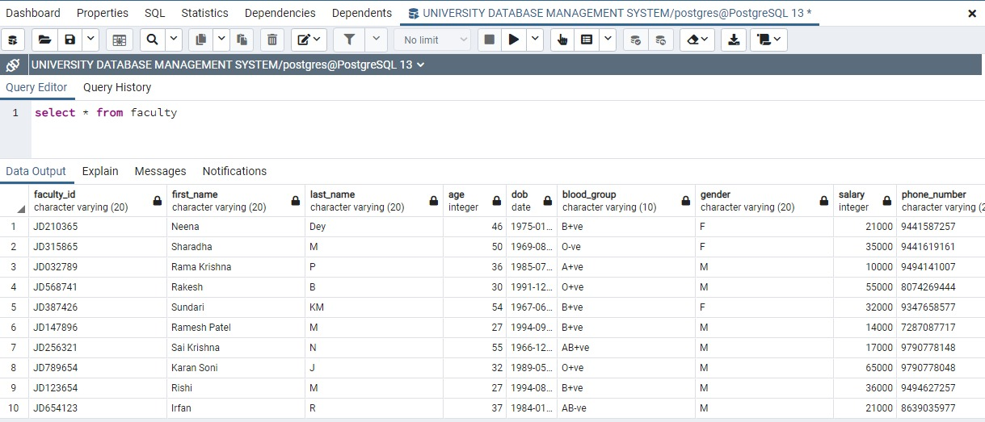
Faculty table

Slide 18
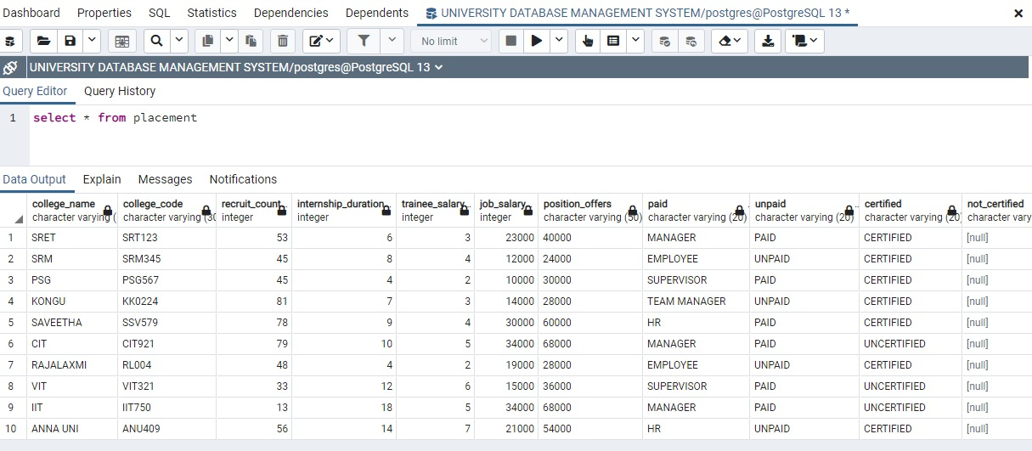
Placement table

Slide 19
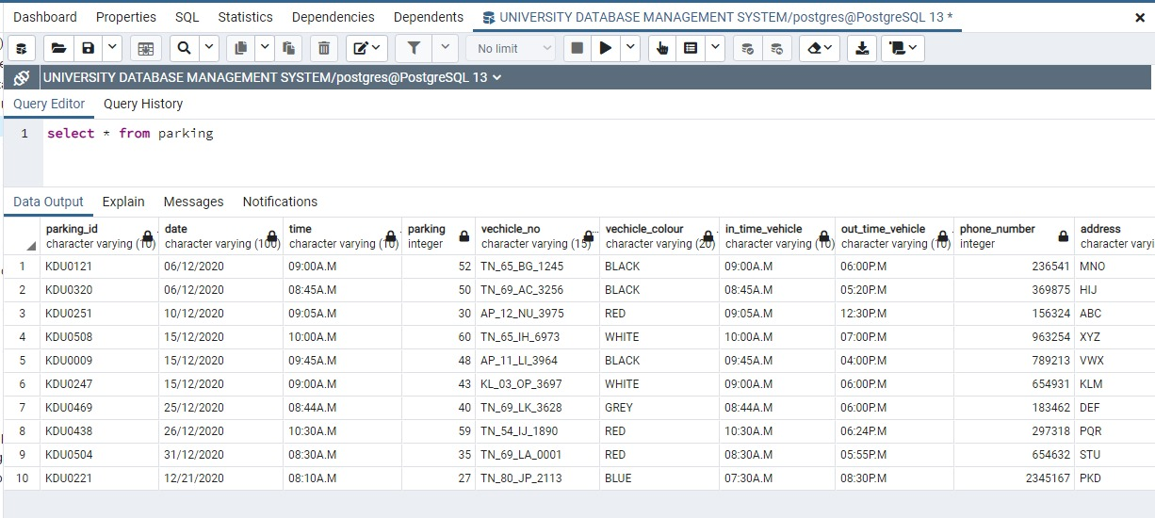
Parking table

Slide 20
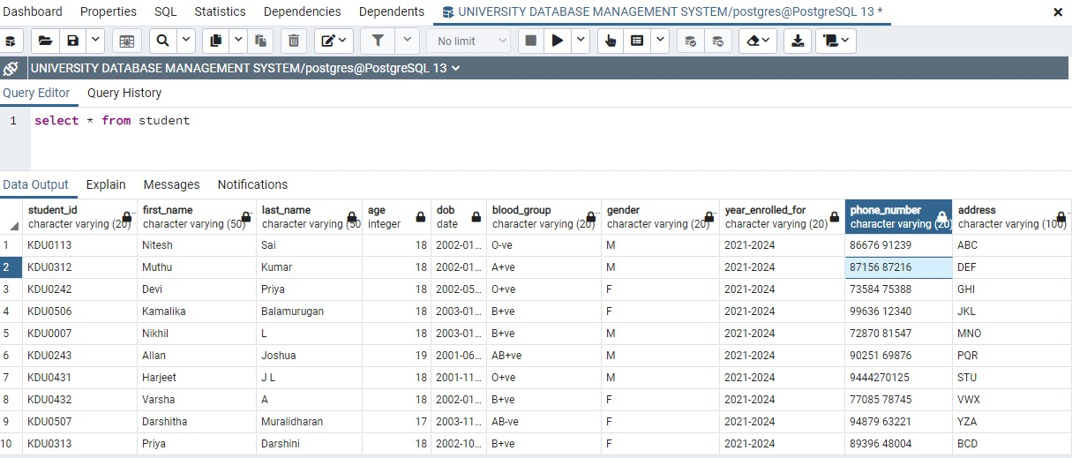
Student table

Slide 21
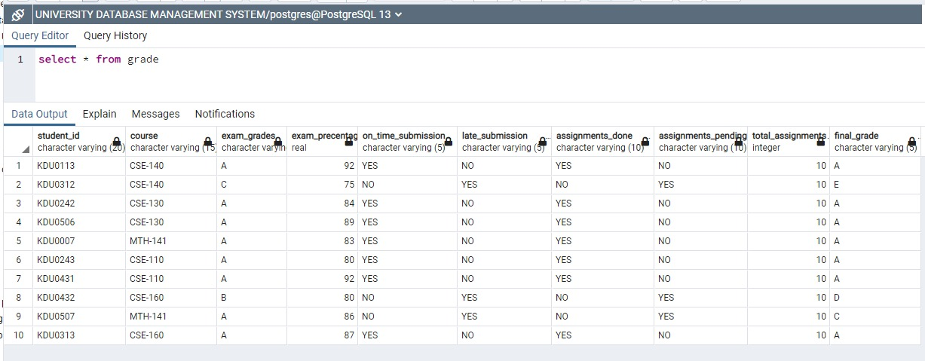
Grade table

Slide 22
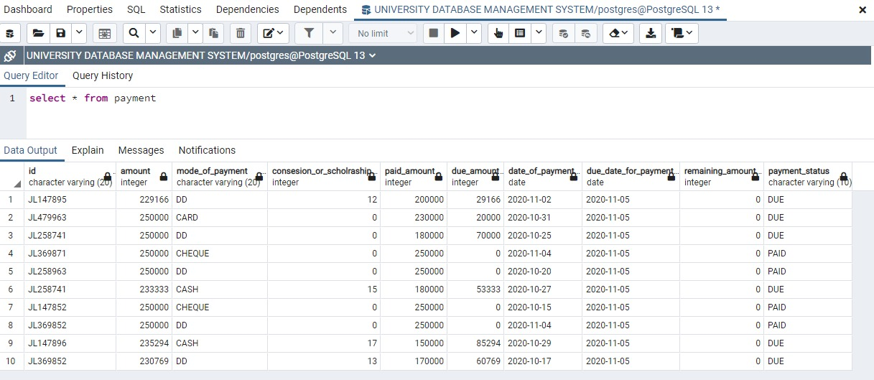
Payment table

Slide 23
PRIMARY KEYS:
* Student_id
Faculty_id
Course_id
Payment_id
Parking_id
Placement_id

Slide 24
FOREIGN KEYS:
In grade table course id becomes a foreign key.
In grade table student id becomes a foreign key.

Slide 25
NORMALIZATION:
To reduce the datas in a normal form and to make it simple. There are three types of normalization. They are:
*first normalization
*second normalization
*third normalization
Normalization can be done by 3 methods. They are:
*insertion anamoly
*updation anamoly
*deletion anamoly

Slide 26
Definitions:
FIRST NORMALIZATION :
There should not be any multiple values available. If it is available we should separate those values and make it distinct.
SECOND NORMALIZATION:
It has to be in first normalization form. It is not supposed to contain any partial dependency.
THIRD NORMALIZATION:
It has to be in second normalization form. It should not contain transitive dependency for non prime attributes.

Slide 27
SECOND NORMALIZATION FOR GRADE TABLE:
STUDENT ID | EXAM GRADES | EXAM PERCENTAGE | ON TIME SUBMISSION | LATE SUBMISSION
COURSE ID | ASSIGNMENTS DONE | ASSIGNEMENTS PENDING | TOTAL ASSIGNMENTS
STUDENT ID | COURSE ID | FINAL GRADE

Slide 28
THIRD NORMALIZATION FOR GRADE TABLE:
STUDENT ID | EXAM GRADES | EXAM PERCENTAGE | ON TIME SUBMISSION | LATE SUBMISSION | COURSE ID
COURSE ID | ASSIGNMENTS DONE | ASSIGNEMENTS PENDING | TOTAL ASSIGNMENTS

Slide 29
FUNCTIONAL DEPENDENCIES FOR SECOND NORMALIZATION GRADE TABLE:
Exam grades,exam percentage,on time submission,late submission has functional dependency on student id.
Assignments done,assignments pending,total assignments has functional dependency on course id.

Slide 30
FUNCTIONAL DEPENDENCIES FOR THIRD NORMALIZATION GRADE TABLE:
Exam grades,exam percentage,on time submission,late submission,course id has functional dependency on student id.
Assignments done,assignments pending,total assignments has functional dependency on course id.

Slide 31
STUDENT TABLE
STUDENT ID | FIRST NAME | LAST NAME | AGE | DOB | BLOOD GROUP | GENDER M/F | YEAR ENROLLED FOR | PHONE NUMBER | ADDRESS
KDU0113 | Nitesh | Sai | 18 | 01/01/2002 | O-ve | M | 2021-2024 | 86676 91239 | ABC
KDU0312 | Muthu | Kumar | 18 | 08/01/2002 | A+ve | M | 2021-2024 | 87156 87216 | DEF
KDU0242 | Devi | Priya | 18 | 11/05/2002 | O+ve | F | 2021-2024 | 73584 75388 | GHI
KDU0506 | Kamalika | Balamurugan | 18 | 05/01/2003 | B+ve | F | 2021-2024 | 99636 12340 | JKL
KDU0007 | Nikhil | L | 18 | 27/01/2003 | B+ve | M | 2021-2024 | 72870 81547 | MNO
KDU0243 | Allan | Joshua | 19 | 05/06/2001 | AB+ve | M | 2021-2024 | 90251 69876 | PQR
KDU0431 | Harjeet | J L | 18 | 24/11/2001 | O+ve | M | 2021-2024 | 9444270125 | STU
KDU0432 | Varsha | A | 18 | 25/01/2002 | B+ve | F | 2021-2024 | 77085 78745 | VWX
KDU0507 | Darshitha | Muralidharan | 17 | 30/11/2003 | AB-ve | F | 2021-2024 | 94879 63221 | YZA
KDU0313 | Priya | Darshini | 18 | 13/10/2002 | B+ve | F | 2021-2024 | 89396 48004 | BCD

Slide 32
FACULTY TABLE
FACULTY ID | FIRST NAME | LAST NAME | AGE | DOB | BLOOD GROUP | GENDER M/F | SALARY | PHONE NUMBER | ADDRESS
JD210365 | Neena | Dey | 46 | 31/01/1975 | B+ve | F | 21000 | 9441587257 | SHD
JD315865 | Sharadha | M | 50 | 05/08/1969 | O-ve | F | 35000 | 9441619161 | JDG
JD032789 | Rama Krishna | P | 36 | 07/07/1985 | A+ve | M | 10000 | 9494141007 | JCF
JD568741 | Rakesh | B | 30 | 21/12/1991 | O+ve | M | 55000 | 8074269444 | NFL
JD387426 | Sundari | KM | 54 | 25/06/1967 | B+ve | F | 32000 | 9347658577 | MFC
JD147896 | Ramesh Patel | M | 27 | 27/09/1994 | B+ve | M | 14000 | 7287087717 | BHF
JD256321 | Sai Krishna | N | 55 | 30/12/1966 | AB+ve | M | 17000 | 9790778148 | KFH
JD789654 | Karan Soni | J | 32 | 26/05/1989 | O+ve | M | 65000 | 9790778048 | IFH
JD123654 | Rishi | M | 27 | 15/08/1994 | B+ve | M | 36000 | 9494627257 | HVH
JD654123 | Irfan | R | 37 | 29/01/1984 | AB-ve | M | 21000 | 8639035977 | YEK

Slide 33
PAYMENT TABLE
ID | AMOUNT (₨) | MODE OF PAYMENT | CONSESION OR SCHOLRASHIP (%) | PAID AMOUNT (₨) | DUE AMOUNT (₨) | DATE OF PAYMENT | DUE DATE FOR PAYMENT | REMAINING AMOUNT (₨) | PAYMENT STATUS
JL147895 | 229166 | DD | 12 | 200000 | 29166 | 02/11/2020 | 05/11/2020 | 29166 | DUE
JL479963 | 250000 | CARD | 0 | 230000 | 20000 | 31/10/2020 | 05/11/2020 | 20000 | DUE
JL258741 | 250000 | DD | 0 | 180000 | 70000 | 25/10/2020 | 05/11/2020 | 70000 | DUE
JL369871 | 250000 | CHEQUE | 0 | 250000 | 0 | 04/11/2020 | 05/11/2020 | 0 | PAID
JL258963 | 250000 | DD | 0 | 250000 | 0 | 20/10/2020 | 05/11/2020 | 0 | PAID
JL258741 | 233333 | CASH | 15 | 180000 | 53333 | 27/10/2020 | 05/11/2020 | 53333 | DUE
JL147852 | 250000 | CHEQUE | 0 | 250000 | 0 | 15/10/2020 | 05/11/2020 | 0 | PAID
JL369852 | 250000 | DD | 0 | 250000 | 0 | 04/11/2020 | 05/11/2020 | 0 | PAID
JL147896 | 235294 | CASH | 17 | 150000 | 85294 | 29/10/2020 | 05/11/2020 | 85294 | DUE
JL369852 | 230769 | DD | 13 | 170000 | 60769 | 17/10/2020 | 05/11/2020 | 60769 | DUE

Slide 34
COURSE TABLE
COURSE ID | TITLE | HOURS | NUMBER OF MODULES | HANDLING FACULTIES | SESSIONS |  | TOTAL SESSIONS | BEGINNING DATE | ENDING DATE
 |  |  |  |  | LAB | THEORY
CSE 140 | DBMS | 60 | 5 | Ramesh Patel | 15 | 85 | 10 | 19/01/2020 | 31/01/2021
MTH 141 | PROBABILITY AND STASTITICS | 60 | 6 | Rama Krishna | 0 | 100 | 10 | 04/01/2021 | 18/01/2021
CSE 160 | DATA STRUCTURES | 60 | 4 | Sundari | 15 | 85 | 10 | 16/11/2020 | 27/11/2020
CSE 110 | C PROGRAMMING | 60 | 7 | Karan Soni | 15 | 85 | 10 | 05/10/2020 | 16/10/2020
CSE 130 | IOT | 60 | 6 | Sai Krishna | 15 | 85 | 10 | 02/11/2020 | 12/11/2020
ENG 170 | ENGLISH | 60 | 5 | Rishi | 0 | 100 | 10 | 02/02/2021 | 13/02/2021
CSE 210 | WEB DESIGNING | 60 | 7 | Neena | 15 | 80 | 10 | 15/02/2021 | 26/02/2021
MTH 142 | INTEGRATION | 60 | 4 | Rakesh | 0 | 100 | 10 | 01/03/2021 | 11/03/2021
MTH 134 | DERIVATIVES | 60 | 6 | Sharadha | 0 | 100 | 10 | 13/03/2021 | 25/03/2021
CSE 165 | JAVA | 60 | 5 | Irfan | 15 | 85 | 10 | 27/03/2021 | 08/04/2021

Slide 35
GRADE TABLE
STUDENT ID | COURSE ID | EXAM GRADES | EXAM PRECENTAGE (%) | ON TIME SUBMISSION YES/NO | LATE SUBMISSION YES/NO | ASSIGNMENT |  | TOTAL ASSIGNMENT | FINAL GRADE
 |  |  |  |  |  | DONE | PENDING
KDU0113 | CSE 140 | A | 92 | YES | NO | YES | NO | 10 | A
KDU0312 | CSE 140 | C | 75 | NO | YES | NO | YES | 10 | E
KDU0242 | CSE 130 | A | 84 | YES | NO | YES | NO | 10 | A
KDU0506 | CSE 130 | A | 89 | YES | NO | YES | NO | 10 | A
KDU0007 | MTH 141 | A | 83 | YES | NO | YES | NO | 10 | A
KDU0243 | CSE 110 | A | 80 | YES | NO | YES | NO | 10 | A
KDU0431 | CSE 110 | A | 92 | YES | NO | YES | NO | 10 | A
KDU0432 | CSE 160 | B | 80 | NO | YES | NO | YES | 10 | D
KDU0507 | MTH 141 | A | 86 | NO | YES | NO | YES | 10 | C
KDU0313 | CSE 160 | A | 87 | YES | NO | YES | NO | 10 | A

Slide 36
PLACEMENT TABLE
COLLEGE NAME | COLLEGE CODE | RECRUIT COUNT | INTERNSHIP DURATION | TRAINEE DURATION | TRAINEE SALARY | JOB SALARY | POSITION OFFERS | PAID/ UNPAID | CERTIFIED/ NOT CERTIFIED
SRET | SRT123 | 53 | 6 | 3 | 23000 | 40000 | MANAGER | PAID | CERTIFIED
SRM | SRM345 | 45 | 8 | 4 | 12000 | 24000 | EMPLOYEE | UNPAID | CERTIFIED
PSG | PSG567 | 45 | 4 | 2 | 10000 | 30000 | SUPERVISOR | PAID | CERTIFIED
KONGU | KK0224 | 81 | 7 | 3 | 14000 | 28000 | TEAM MANAGER | UNPAID | CERTIFIED
SAVEETHA | SSV579 | 78 | 9 | 4 | 30000 | 60000 | HR | PAID | CERTIFIED
CIT | CIT921 | 79 | 10 | 5 | 34000 | 68000 | MANAGER | PAID | UN CERTIFIED
RAJALAKSHMI | RL004 | 48 | 4 | 2 | 19000 | 28000 | EMPLOYEE | UNPAID | CERTIFIED
VIT | VIT321 | 33 | 12 | 6 | 15000 | 36000 | SUPERVISOR | PAID | UNCERTIFIED
IIT | IIT750 | 13 | 18 | 5 | 34000 | 68000 | MANAGER | PAID | UNCERTIFICATE
ANNA UNI | ANU409 | 56 | 14 | 7 | 21000 | 54000 | HR | UNPAID | CERTIFIED

Slide 37
PARKING TABLE
STUDENT ID | DATE | TIME | PARKING SPOTPLACE | VEHICLE NO | VEHICLE COLOUR | VEHICLE IN-TIME | VEHICLE OUT-TIME | PHONE NUMBER | ADDRESS
KDU0121 | 06/12/2020 | 09:00 A.M | 52 | TN 65 BG 1245 | BLACK | 09:00 A.M | 06:00 P.M | 236541 | MNO
KDU0320 | 06/12/2020 | 08:45 A.M | 50 | TN 69 AC 3256 | BLACK | 08:45 A.M | 05:20 P.M | 369875 | HIJ
KDU0251 | 10/12/2020 | 09:05 A.M | 30 | AP 12 NU 3975 | RED | 09:05 A.M | 12:30 P.M | 156324 | ABC
KDU0508 | 15/12/2020 | 10:00 A.M | 60 | TN 65 IH 6973 | WHITE | 10:00 A.M | 07:00 P.M | 963254 | XYZ
KDU0009 | 15/12/2020 | 09:45 A.M | 48 | AP 21 LI 3964 | BLACK | 09:45 A.M | 04:00 P.M | 789213 | VWX
KDU0247 | 15/12/2020 | 09:00 A.M | 43 | KL 03 OP 3697 | WHITE | 09:00 A.M | 06:00 P.M | 654931 | KLM
KDU0469 | 25/12/2020 | 08:44 A.M | 40 | TN 69 LK 3628 | GREY | 08:44 A.M | 06:00 P.M | 183462 | DEF
KDU0438 | 26/12/2020 | 10:30 A.M | 59 | TN 54 IJ 1890 | RED | 10:30 A.M | 06:24 P.M | 297318 | PQR
KDU0504 | 31/12/2020 | 08:30 A.M | 35 | TN 69 LA 0001 | RED | 08:30 A.M | 05:55 P.M | 654632 | STU

Slide 38
